Slide 1

Project presentation Diabetes prediction using python
Presented by
T.SANJAY SURYA
MD. SULEMAN AHMED

Slide 2


Slide 3
Diabetes prediction using python
Diabetes has become one of the major causes of national disease and death in most countries.
According to the International Diabetes Federation report, the figure is expected to rise to more than 642 million in 2040, so early screening and diagnosis of diabetes patients have great significance in detecting and treating diabetes on time.
Diabetes is a multifactorial metabolic disease, its diagnostic criteria is difficult to cover all the ethology, damage degree, pathogenesis and other factors, so there is a situation for uncertainty and imprecision under various aspects of medical diagnosis process.
With the development of Data mining, researchers find that machine learning is playing an increasingly important role in diabetes research.
Machine learning techniques can find the risky factors of diabetes and reasonable threshold of physiological parameters to unearth hidden knowledge from a huge amount of diabetes-related data, which has a very important significance for diagnosis and treatment of diabetes.
So this project provides a survey of machine learning techniques that has been applied to diabetes data screening and diagnosis of the disease.
In this project, conventional machine learning techniques are described in early screening and diagnosis of diabetes.
More over deep learning techniques which have a significance of biomedical effect are also described.

Slide 4
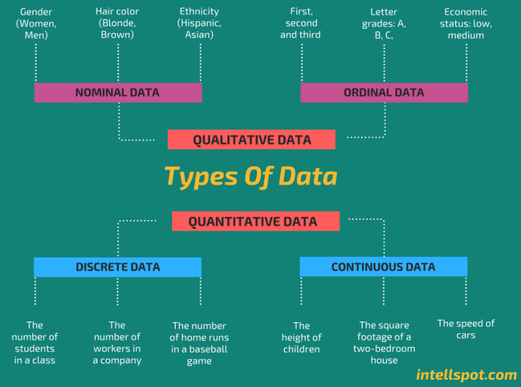

Slide 5
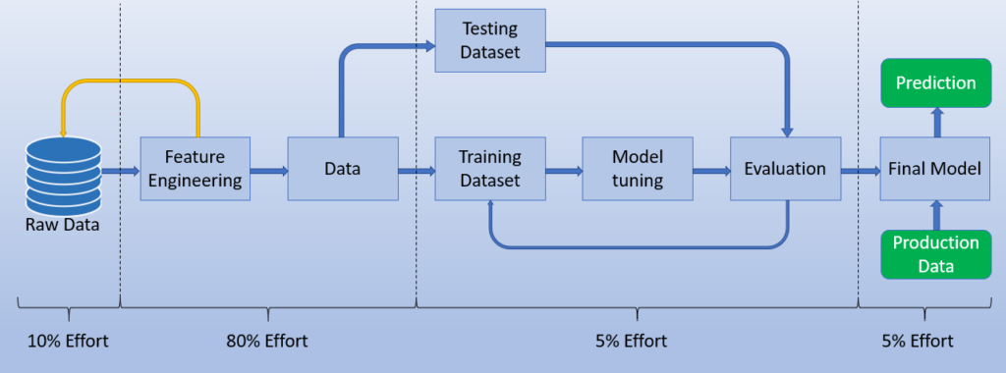
Steps of implementing the model

Slide 6
Softwares and libraries required
Anaconda Navigator -Jupyter notebook.
Kaggle notebook for dataset-PIMA Indian diabetes dataset.
Libraries:
Pandas
Numpy
ScikitLearn.
Seaborn.

Slide 7
Algorithms used
KNeighborsClassifier.
SVC.
GaussianNb
Random forest classifier.

Slide 8
Conclusion
The main aim of this project was to design and implement Diabetes Prediction Using Machine Learning Methods and Performance Analysis of that methods and it has been achieved successfully.
The proposed approach uses various classification and ensemble learning method in which SVM, KNN, Random Forest, Decision Tree, Logistic Regression and Gradient Boosting classifiers are used.
The Experimental results can be assist health care to predict and make early decision to cure diabetes and save humans life.

Slide 9
Thank you
EXPOSYS DATA LABS

